Slide 1
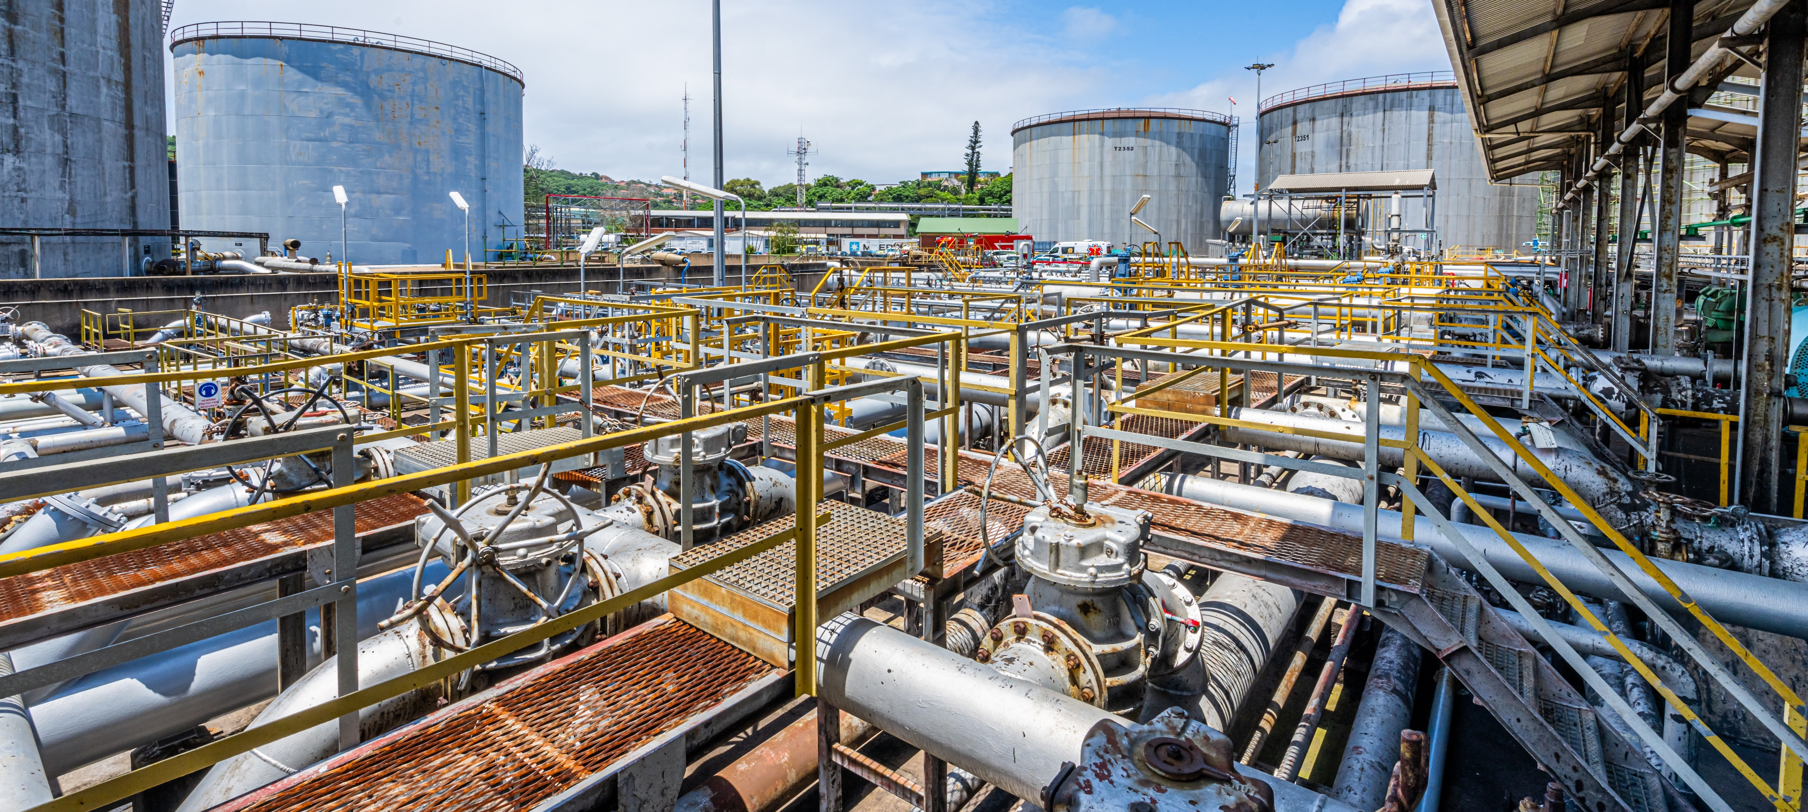

HSSE Stop: Process Safety Fundamental 1.
Always use 2 barriers for Chemical/ Hydrocarbon drain and vents.
19th March 2026

Slide 2
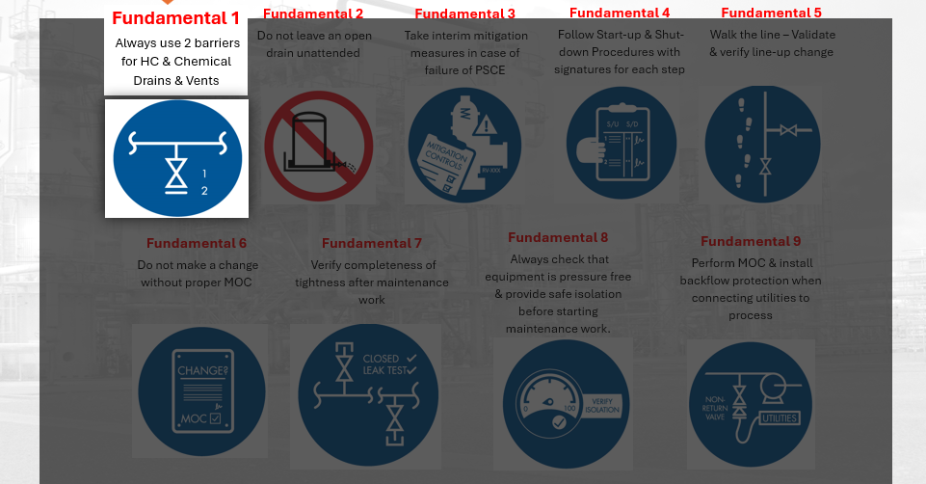
Introduction
What are Process Safety Fundamentals (PSF)?
These are 10 process safety and operational basics that help to prevent LOPCs and process safety incidents.
How did the 10 PSFs come about?
Through investigating and learning from past LOPCs and process safety incidents within Shell sites.
What is the aim of PSFs?
To improve the identified behaviours that usually lead to LOPCs

Slide 3
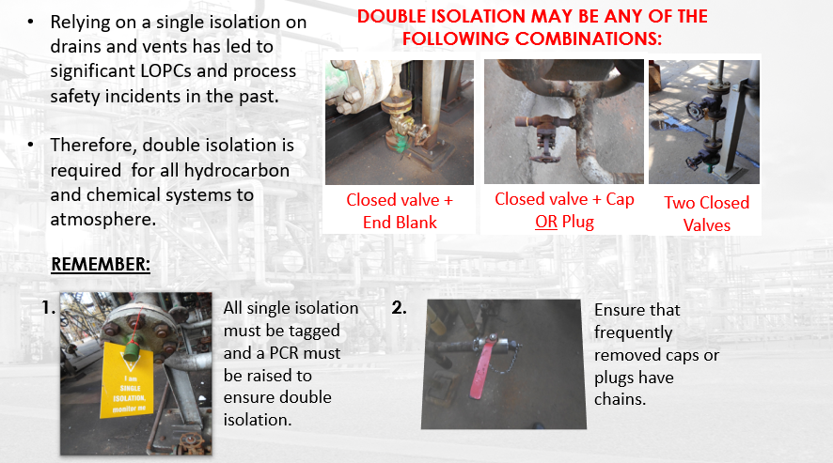
#1 - Always Use Two Barriers For Hydrocarbon & Chemical Drains & Vents
(Double Isolation)

Slide 4
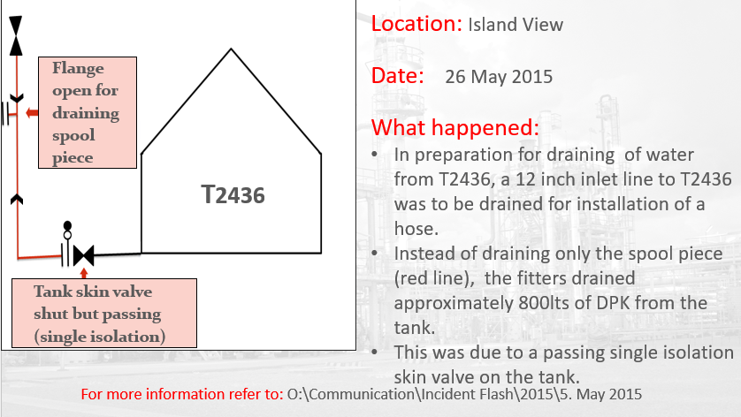
Island View Example

Slide 5
Points to remember
Process Safety Fundamentals are there to protect you and save lives.
Process Safety Fundamentals are there to prevent equipment damage.
Ensure double isolation for all drains and vents going to atmosphere.

Slide 6
Discussion Points
Can you think of any other previous incident at SAPREF that occurred from failure to achieve double isolation? What were the consequences and learnings from such incidents.
What are some of the reasons for not having double isolation to atmosphere? How can these be eliminated in future?
What can you do in your current role to ensure that double isolation is achieved on site at all times? In your discussion consider:
  Following of procedures
  Conducting unit checks
  Conducting safety walks
  PSFO audits etc.

