Slide 1
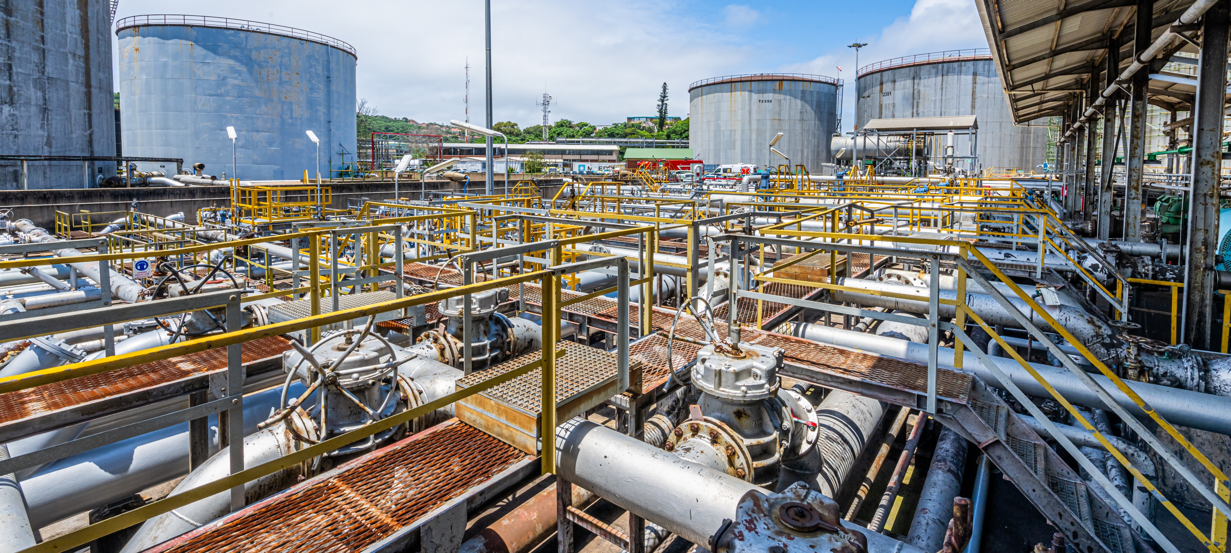

9 Life Saving Rules
September 2025

Slide 2


Industry life-saving rules at a glance
TITLE
INDUSTRY LIFE-SAVING RULES
AT A GLANCE
Or scan the QR code to watch the 9 life-saving animations on Vimeo
Bypassing Safety Controls
Confined Space
Driving
Energy Isolation
Hot Work
Line of Fire
Safe Mechanical Lifting
Work Authorization
Working at Height

Slide 3
Rule 1 Bypassing Safety Controls
RULE 1
BYPASSING SAFETY CONTROLS
Obtain authorisation before overriding or disabling safety-controls
I understand and use safety-critical equipment and procedures which apply to my task
I obtain authorisation before:
disabling or overriding safety equipment
deviating from procedures
crossing a barrier
LSR Bypassing Safety Controls

Slide 4
Rule 2 Confined Space
RULE 2
CONFINED SPACE
Obtain authorisation before entering a confined space
I confirm energy sources are isolated
I confirm the atmosphere has been tested and is monitored
I check and use my breathing apparatus when required
I confirm there is an attendant standing by
I confirm a rescue plan is in place
I obtain authorisation to enter
LSR Confined space entry

Slide 5
Rule 3 Driving
RULE 3
DRIVING
Follow safe driving Rules
I always wear a seatbelt
I do not exceed the speed limit, and reduce my speed for road conditions
I do not use phones or operate devices while driving
I am fit, rested and fully alert while driving
I follow journey management requirements
LSR Driving

Slide 6
Rule 4 Energy Isolation
RULE 4
ENERGY ISOLATION
Verify isolation and zero energy before work begins
I have identified all energy sources
I confirm that hazardous energy sources have been isolated, locked, and tagged
I have checked there is zero energy and tested for residual or stored energy
LSR Energy Isolation

Slide 7
Rule 5 Hot Work
RULE 5
HOT WORK
Control flammables and ignition sources
I identify and control ignition sources
Before starting any hot work:
I confirm flammable material has been removed or isolated
I obtain authorisation
Before starting hot work in a hazardous area I confirm:
a gas test has been completed
gas will be monitored continually
LSR Hot Work

Slide 8
Rule 6 Line of Fire
RULE 6
LINE OF FIRE
Keep yourself and others out of the line of fire
I position myself to avoid:
moving objects
vehicles
pressure releases
dropped objects
I establish and obey barriers and exclusion zones
I take action to secure loose objects and report potential dropped objects
LSR Line of Fire

Slide 9
Rule 7 Safe Mechanical Lifting
RULE 7
SAFE MECHANICAL LIFTING
Plan lifting operations and control the area
I confirm that the equipment and load have been inspected and are fit for purpose
I only operate equipment that I am qualified to use
I establish and obey barriers and exclusion zones
I never walk under a suspended load
LSR Safe Mechanical Lifting

Slide 10
Rule 8 Work Authorisation
RULE 8
WORK AUTHORISATION
Work with a valid permit when required
I have confirmed if a permit is required
I am authorised to perform the work
I understand the permit
I have confirmed that hazards are controlled and it is safe to start
I stop and reassess if conditions change
LSR Work Authorisation

Slide 11
Rule 9 Working at Height
RULE 9
WORKING AT HEIGHT
Protect yourself against a fall when working at height
I inspect my fall protection equipment before use
I secure tools and work materials to prevent dropped objects
I tie off 100% to approved anchor points while outside a protected area
LSR Working at Height

