Slide 1
Keep Your Head in the Game!
Back to Work

Slide 2
Check-in
Welcome to our colleagues returning from your holiday break. We are happy to see you refreshed and energised for this new year.
Team Leaders/ Supervisors: Carry out check-in with all team members
Check-in Guidelines:
  Everyone in good health?
  Anyone injured or fell ill during the break?
  Anyone suffered trauma (e.g. Personal loss/death, victim of crime, etc..?)
  Stress – e.g. family issues, children ok?
  Well rested – e.g. Was anyone driving through the night and will not be alert for the full work day?
  Any other concerns........?
Notes:
Remind staff who have been unwell or injured during the break to see the clinic for a return to work assessment

Slide 3
Welcome from the GM
GMs Message.mp4

Slide 4
Risks Related to Operating Terminal
As we start a new year it is important to remind ourselves of the risks related to our operations.
Buncefield Disaster - ECI-HUB
What incidents have we had that could of results in a similar disaster?
Notes:
Let’s continue to remember the Buncefield Incident and compare it with the two MOGAS incidences we have in two consecutive years. We have allowed ourselves to fail lucky twice and we can’t allow it again.

Slide 5
What is SAPREF’s Safety Vision during 2026?
SAFETY is our No.1 Priority – we plan our work properly to ensure that risks are adequately managed while ensure work is carried out efficiently.
We are all aware of our roles and responsibilities and take personal accountability.
We comply with rules and procedures – when we are not able to comply we escalate to our line manager for support.
We provide a Psychological safe environment where People feel comfortable, supported and respected to share their concerns, ask questions if they are unsure, speak up when things go wrong and to offer up their ideas and observations. (How I respond Matters)
We practice a learner mindset by reporting and investigating incidents and near misses so that learnings can be shared and processes can be improved.
We intervene respectfully, because we care – “Be your brother’s keeper”.
Notes:
At SAPREF we put Safety of our People before Production and Maintenance Targets and therefore, let’s not carry out any work at all costs
At SAPREF we follow our Rules and Procedures, if we feel there are opportunities of improvement, we engage and escalate and amend if necessary

Slide 6
2025 HSE Performance
MVA’s Themes
Drivers' misjudgment of distance from barriers
Non-compliance to Road traffic act – STOP sign.
Parking in non-designated areas
Interventions and learnings
IV road safety issues being addressed via TNPA.
3-month citation in case of negligence.
Importance of parking in designated areas.
SAPREF to provide designated parking bays at Site 1 Control room & Contractor's yard.
SPs to minimise number of private vehicles and utilise shuttle buses
TRCs Themes
Risk recognition
Fencing related
Notes:
Did we fail safe or fail lucky?
Have we taken the learnings from these incidents and incorporated them into our ways of work to prevent repeat incidents?

Slide 7
2025 HSE Performance
2025 LOPC 10-100kg
LSFO line at Berth 10 developed a flange leak due to thermal pressure during squeeze test.
A hydrocarbon leak came out in a fine spray from Berth 5 during a squeeze test.
T2485 overflowed during transfer from T2101.
Learnings
Effective and safe isolation of equipment is a critical barrier in preventing LOPCs.
Understanding and use of procedures is critical for safe execution of work.
Strengthen effective response to alarms and operator response to prevent escalation.
Use of Stop Work Authority if crucial activities are not proceeding as expected.
Plant rounds play a vital role in early leak detection and preventing incidents – find small, fix small.
Robust and preventative maintenance is essential to maintaining equipment integrity.
Themes
Use of Procedures
Proactive alarm intervention
Preventative maintenance.
Notes:
Did we fail safe or fail lucky?
Have we taken the learnings from these incidents and incorporated them into our ways of work to prevent repeat incidents?

Slide 8
Keep Your Head in the Game - LET’S DISCUSS HOW !
If you answer NO to any of the questions below, please discuss what you need to do to change your response to YES.
Do I know the rules (LSR, HSSE Specifications, PTW, CSE , Work Hazard Categories (HSSE.SF.0212)?
Do I have the valid competency requirements (medicals, inductions, clearance receiver, hot-work licence, appointments, Drivers license etc)?
Do I have the correct PPE?
Do I understand the reporting protocol in case of an incident?
Is my head in the game and am I ready to work safely?

Slide 9
Basic Rules to Work Safely
Do I have a valid permit/s e.g. Clearance Certificate, Safety Certificate etc.?
LMRA to be focused on the job to be done.
Am I clear about the work to be done?
Have we conducted a site visit prior to starting work?
Has the supervisor/team leader highlighted the risks in my job? Do I fully understand this? Have I discussed the HAZARDS & RISKS with the team utilising a RAMS/ LMRA?
Have I considered heat stress? Am I hydrating properly?(where applicable)
Do we have new people in our team(s)? Have they gone through on-boarding? Are they familiar with the work site and layout?
Have we planned for the morning TBT and afternoon Refocus Sessions?
Note:
Use of H2S monitors is mandatory at all Sites.
Use of Electronic equipment e.g. smart watches, car keys etc; are not allowed in process areas.

Slide 10
Message from Leadership
If you see something that is unsafe or at risk, Intervene, SPEAK UP immediately. Use your Stop Work Authority.
If you STOP a task for a safety reason, we WILL back you up.
If you raise a safety concern, we WILL ADDRESS IT PROMPTLY.
Safety Interventions can save lives.

Slide 11
HSE Commitment
Discussion with team:
Based on the data from the previous slide:
What behavioural change can I make to prevent serious injuries and incidents?
(Commitment from each employee – Behaviours to stop, start or improve)
What can we do as a department/section/service provider to achieve “Goal Zero”
( 3 things that the department/section/service provider will do to improve safety in 2026)
Note:
Kindly email summary of your Safety Commitments and attendance registers to SAPREF Safety: mngomal@sapref.com

Slide 12
BACKUP SLIDES

Slide 13
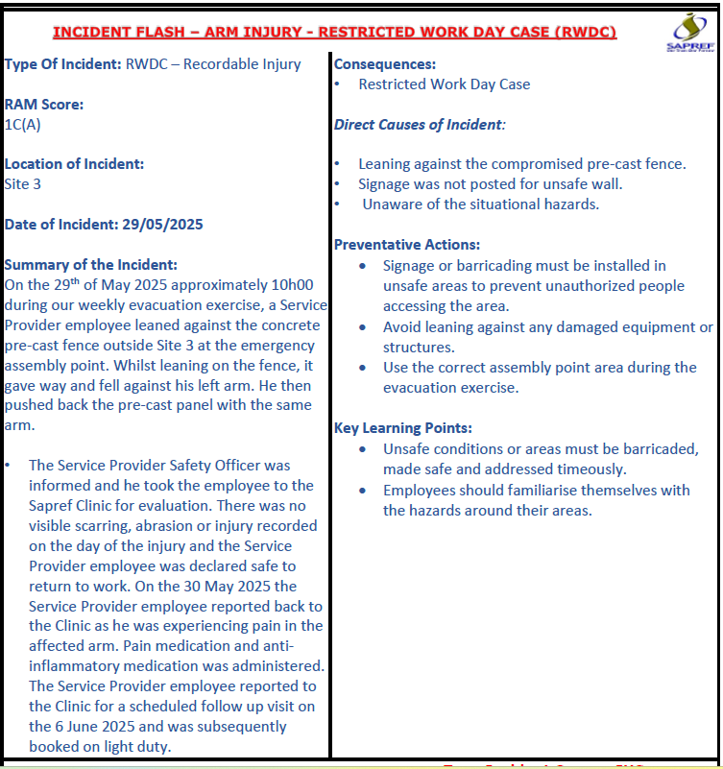
Medical Treatment Case – Recordable Injury

Slide 14
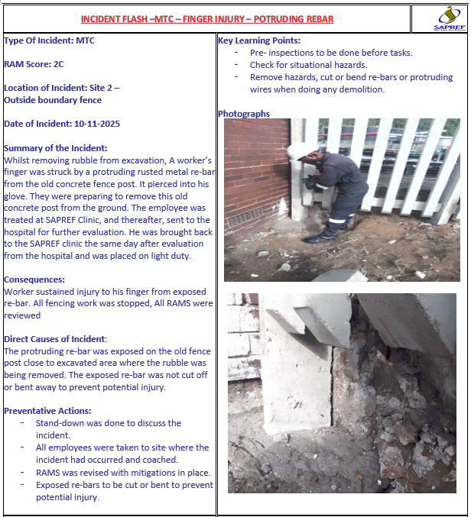
Medical Treatment Case – Recordable Injury

Slide 15
2025 LSRs
Incident_Date
19-05-2025 | Entry into CSE without authorisation - On the 19th of May 2025 approximately 10:00 at site 3 T2350 during a high-risk safety walk it was observed that the confined space entry register has 3 employees signed in however 6 employees came outside of the tank after the emergency horn was activated
01-06-2025 | Safety harness not hooked up on an Orange tagged scaffold

Slide 16
Motor Vehicle Accidents
Incident_Date | Full description
17-04-2025 | Whilst attempting to park fire truck into fire station, operator accidently bumped into stationary vehicle alongside fire station. Drivers alcohol test with security was negative and accident report was placed at the Brighton Saps. All parties were informed.
11-07-2025 | On Friday 11.07.2025 at 11:10am a Remistar employee was involved in an accident with a train. The train hopper carrier extended bracket hooked the bakkie on the front door and dragged it forward from where it was parked. Isuzu Bakkie sustained serious damage. The train dragged the bakkie for about 8 metres. The driver of the vehicle was alone in the vehicle at the time of the accident. There were no injuries.
05-08-2025 | On the 5th of August 2025 TMS employee was reversing to the parking in site 1, While reversing, the vehicle came very to the fence which resulted to bakkie to hitting the fence. There were no damages to the vehicle and sapref property.
02-10-2025 | Summary of Incident at Contractor's Yard The Environ-Clean driver was driving forward and trying to turn to get to the work site (Ref: T2433 Spade P-240884/P-240807, AVGAS Rundown Line, CAIR). During the turn, the driver misjudged the space. The flagman was outside the vehicle at the time. The driver said he told the flagman not to worry because he was driving forward, not in reverse, and that the area wasn’t a process unit.
25-09-2025 | Driver entered the parking lot at Site 1 alongside the walkway. While manoeuvring, he misjudged his vehicle positioning, which led to the front left bumper bumping into the light pole power supply box. The incident caused damage to the supply box and slight damage to the vehicle bumper. No injuries were sustained.

Slide 17
Motor Vehicle Accidents (contd’)
Incident Date | Full description
03-11-2025 | At approximately 13h16 on 03 November 2025, a TMS employee was driving a Toyota bakkie (registration number JY57 MZ GP) west-bound along Borneo Road inside Culter Complex towards the Wharf side Road Intersection. The driver stopped at the stop sign, waiting for a truck travelling from the right-hand side(South-bound) to pass before turning left onto Wharf Side Road.
12-11-2025 | Whilst exiting parking lot outside Site 1 new building, i turned and hit the right hade side front fender against the concrete jersey barrier. Vehicle registration number is CM08CK-ZN. Reported to the Team Leader and Security
14-11-2025 | Operator parked next to site 1 gate while it was closed, on his return he found the gate to have been opened and had swung and made contact with the body of the bakkie. The vehicle sustained a slight scratch on the body.
18-11-2025 | The Tankage vehicle DD53BJ- ZN was parked at the Enserve workshop entrance in Pinetown, during offloading of 23EV7, when it was struck by a metal piping stand that was toppled by heavy winds, resulting in damage to the bakkie.
20-11-2025 | While operator was leaving the site 3 car park, the site 1 bakkie made contact with an open door on the electrical bakkie. There was minor damage sustained to the rear fender of the site 1 bakkie and rear door of the electrical bakkie. MVA was reported and all relevant parties were informed

Slide 18
FIRST AID INJURIES
Incident Date | Full Description
First Aid Cases
08-09-2025 | While moving a cup of tea on the table, hot tea spilled on the worker’s hand. Injured person reported to the Clinic for treatment.
09-06-2025 | An employee was stung by a bee on the leg at Site 3 toilets. The injured employee reported to the Clinic and was given first aid treatment and returned to normal duties.

